Slide 1

Predicting Gender from Names Using Excel: A Train & Validate Approach
Email : gokul11sm@gmail.com
Name : Gokul S

Slide 2
Contents:
PROBLEM STATEMENT
Approach
Workflow
Pivot Analysis
Validation data & Accuracy
Visual Representation
Measurement Of Accuracy
Precision, Recall & F1 Calculation

Slide 3
PROBLEM STATEMENT :
Predict the gender based on their names using Excel. In many Business and research scenarios, determining the gender of individuals from their names is essential for data analysis, marketing strategies. However, manually identifying gender from names is time-consuming and prone to errors.
Importance of gender prediction for analytics and personalization.
• Challenge: Names don’t always clearly indicate gender.
• Objective: Develop a reliable method using Excel and pivot analysis.

Slide 4
Approach :
Our approach will predict gender based on the last letter of a name. We hypothesize that the last letter provides a basis for a viable prediction model. We will use a Stratified Split approach to assess the accuracy of this method.
Stratified Split Approach :
For this approach, we will first divide the dataset into a 70:30 ratio, with 70% of both the female and male data in the training set and the remaining 30% in the validation set.
We will perform our analysis on the training set and then use this analysis to predict genders in the validation set.
It is crucial to avoid sorting the data by name. Doing so would bias the training and validation sets, with the training set potentially containing mostly names starting with early letters of the alphabet and the validation set containing names starting with later letters. This uneven distribution would lead to inaccurate results.

Slide 5
Workflow:
1️⃣ Data Collection & Preprocessing
Gather a dataset with names & corresponding genders.
Split into Training and Validation data.
2️⃣ Feature Extraction
Extract name-based features (e.g., last letter using RIGHT(A2,1)).
Store extracted features in new columns.
3️⃣ Training the Model
Use Pivot Tables to identify common name patterns for each gender.
Analyze trends by placing columns in PivotTable fields.
4️⃣ Validating the Model
Apply trained rules to the validation dataset.
Use VLOOKUP to compare names with a predefined gender list.
5️⃣ Accuracy Check
Use IF statements to classify and mark predictions as Correct/Incorrect.
6️⃣ Calculate Accuracy
Compute accuracy percentage: (Correct Predictions / Total Entries) * 100.
Test and refine the model.

Slide 6
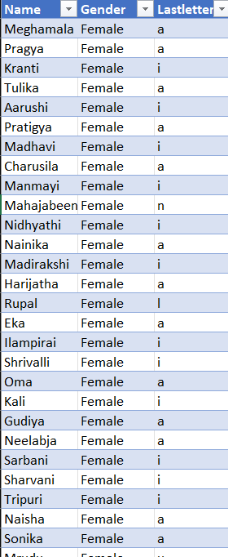
Pivot Analysis & Data :
First, we trained the model using the training dataset by creating a Pivot Table that mapped the last letter of names to the percentage distribution of genders.
Next, we applied this trained model to the validation dataset, predicting gender based on the last letter of each name and expressing the results as percentages.
Finally, we compared the predicted genders with the actual genders to evaluate the model's accuracy.

Slide 7
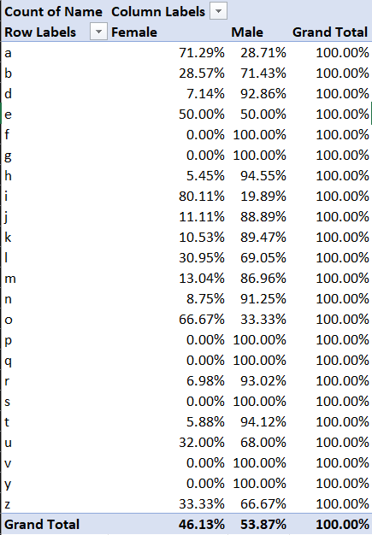
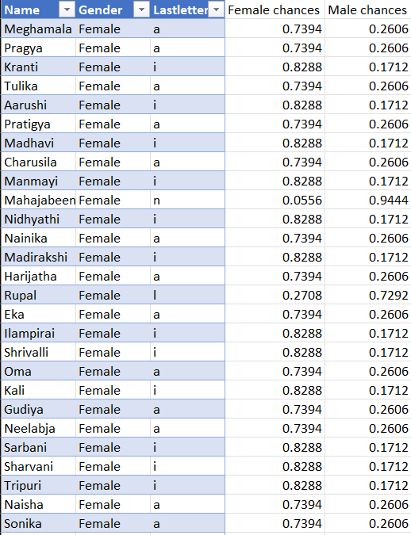
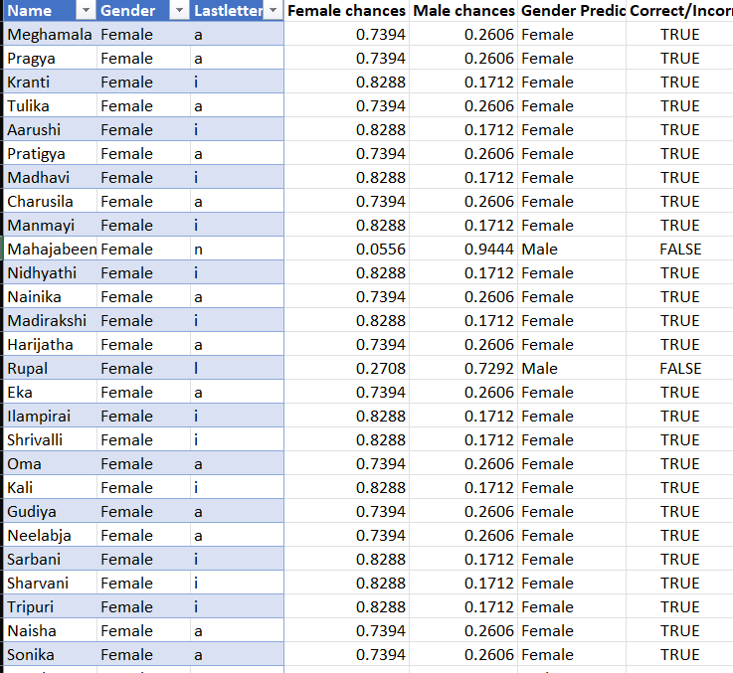
VALIDATION DATA & ACCURACY:

Slide 8
VISUAL REPRESENTATION OF PREDICTED DATA :

Slide 9
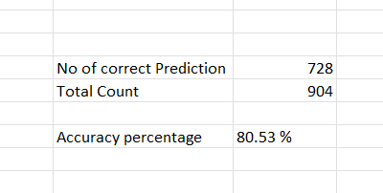
MEASUREMENT OF ACCURACY
The accuracy of gender prediction model is the proportion of correct predictions (true positives + true negatives) out of the total number of predictions.
Formula for Accuracy: Accuracy= Number of Correct Predictions /Total Number of Prediction

Slide 10
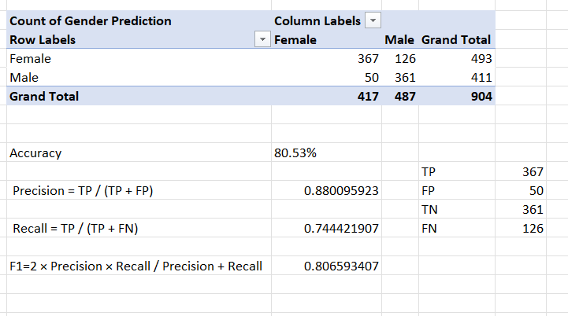
Precision, Recall & F1 Calculation:
Calculating F1 Score in Excel:
▪ The F1 Score is calculated as: F1=2 × Precision × Recall / Precision + Recall
▪ Where: Precision = TP / (TP + FP)
Recall = TP / (TP + FN)

Slide 11
THANK YOU

